Slide 1
Exhibition Design Presentation

Slide 2
Our Role and what we wanted to achieve
As a team we have to gather various measurements from the gallery space and work out how much space each student has. Considering factors like what they are exhibiting, if they need to be near a plug, what size prints they can exhibit, how many tables, plinths and monitors.
We have to think about what could also help the flow such as lighting, will we be moving any lights or having any colour lights? or sound, will videos have headphones or being playing aloud?
Work closely with the other exhibition teams to make sure things run smoothly.
We wanted to achieve a high quality, professional experience where everyone's work flows throughout the gallery seamlessly.
Notes:
Kirstie – Talk about how meetings will help us work as a team to achieve our goals.
Expand on how we would work with teams – Promotion – work together to make the poster –Install – relay the amount of plinths and the plan of the exhibit .

Slide 3
Goals that we set ourselves
The goals set for the team required a understanding of how to organise the work in relation the limited space to work with. In order for this goal to be achieved it was crucial to be aware of other issues and to set goals to tackle these issues. For example certain sections of the space are categorised into still and moving imagery shown around the gallery, the space/ direction of where the viewer will walk and thinking about how to use resources in relation to the amount of work to be shown. Through team effort and understanding the main goals reflecting back would be:
  To demonstrate the ability to design a floor plan with limited space and resources
  Identify and solve any potential issues with a individuals work and to compromise with the individual to agree on how it should be presented
  Clearly communicate with other groups as well as individuals to provide further understanding of how to design the space
Notes:
Chandler – Talk about the importance of clear communication between our group and the other exhibit groups.
This brings clarity to the exhibit. For example the consequences of miscommunicating the amount of plinths.

Slide 4
What we need to consider
Equipment
We contacted every student that was showing and asked them what equipment they required for the exhibition. As fashion photography were exhibiting the week before, we was able to deduct the equipment they were using from our own list.
Lighting
As there is a lot of people showing in the exhibition it is important that the lighting in the Nucleus Arts Gallery was going to be sufficient. The gallery has LED lighting fixtures, that can be moved if necessary.
Spacing between work and disability access
We didn't want the exhibition to seem cramped, so to resolve this problem, we measured the total amount of space in the gallery and dived each wall up by the number of people displaying their work on it. By considering the amount of space each person was getting, allowed us to leave five inches between work, leaving plenty of room.
Notes:
Grace – Expand on the what equipment (plinths, monitors, tables, chairs).
Liaised with fashion as well. Why we chose to space out the work (Light coverage).
Talk about disability access and why we wanted to make sure the exhibit was wheelchair friendly.

Slide 5
Health and Safety
We wanted to create a centre floor plan to show work in a professional manner yet keep it safe for our guests to walk around. This raised a few questions when we was coming up with ideas and plan
We had an idea of a free standing wall but we decided it wouldn't be acceptable for multiple reasons; 1) with the low ceilings, the walls would have to be tailor-made which wouldn't be time and money efficient. 2) could disrupt the flow of viewers. But most importantly. 3) it could become a hazard for the disabled and young children.
We needed to be able to run cables safely; to which we was able to come up with the idea of having the monitors spread out along the walls and using industrial extension leads and gaffer-tape the cables to the floor will decrease the trip hazard but it will also keep the cables out of sight of young children.
Some students had to comprise their initial ideas of what they wanted to exhibit as they wanted to create an installation.
Notes:
Libby – Discussing how health and safety is a top priority.
Give the example – no monitors in the centre. Limit of plug sockets, 7 monitors for 7 plugs.
Talk about one student wanted a bike, another wanted various objects for a floor installation.

Slide 6
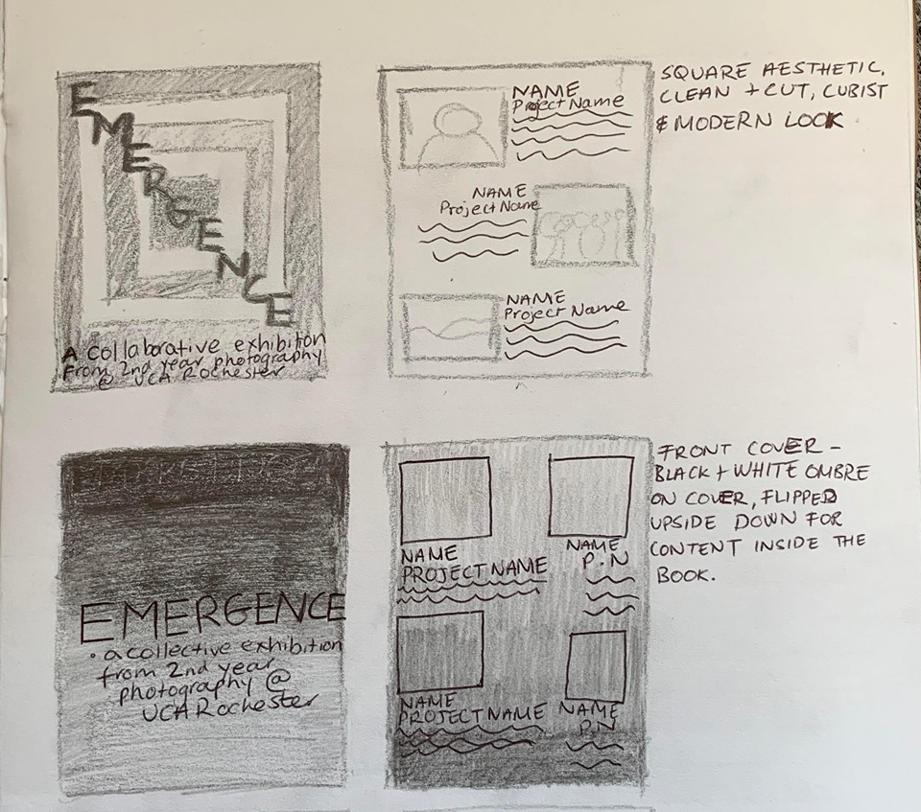
Initial Poster Ideas
Notes:
Hayley – Explain how these were some of the original ideas.
How we sent these to Promotions team

Slide 7
Initial Ideas
We agreed we wanted to create a centre show of work to break up the space as well as providing a directional pathway for viewers to explore everyone's work, as we didn’t want all students work hung or running along the walls in a uniformed manner.
Therefore we thought of having a selection of TV monitors, on plinths, for students who are presenting videos.
Have a free-standing wall that would run half the width of the room to allow various students hang their work
We also came up with a third option, to have a some work printed onto a fabric banner and suspend them from the middle beams that run the width of the room.
We chose to not have a book table as this may confuse the viewer and this also meant an unnecessary extra table.
We also wanted to hold and refreshment table and a zines table within the space. We agreed to keep the idea of the refreshments at the entrance but also have a plinth with a brochure stand next to the door to display the zines, while have an adhesive stand on the wall next to the individual work to display the books.
Notes:
Libby – Talk about how the Gallery was a confined space (low ceilings, narrow walls). How it jumpstarted our creative minds.
How the free standing was for students who were exhibiting more than two images.
The banner could also be an advertisement as well
However, we thought that having two tables in the L shape by the entrance would take up too much space.

Slide 8
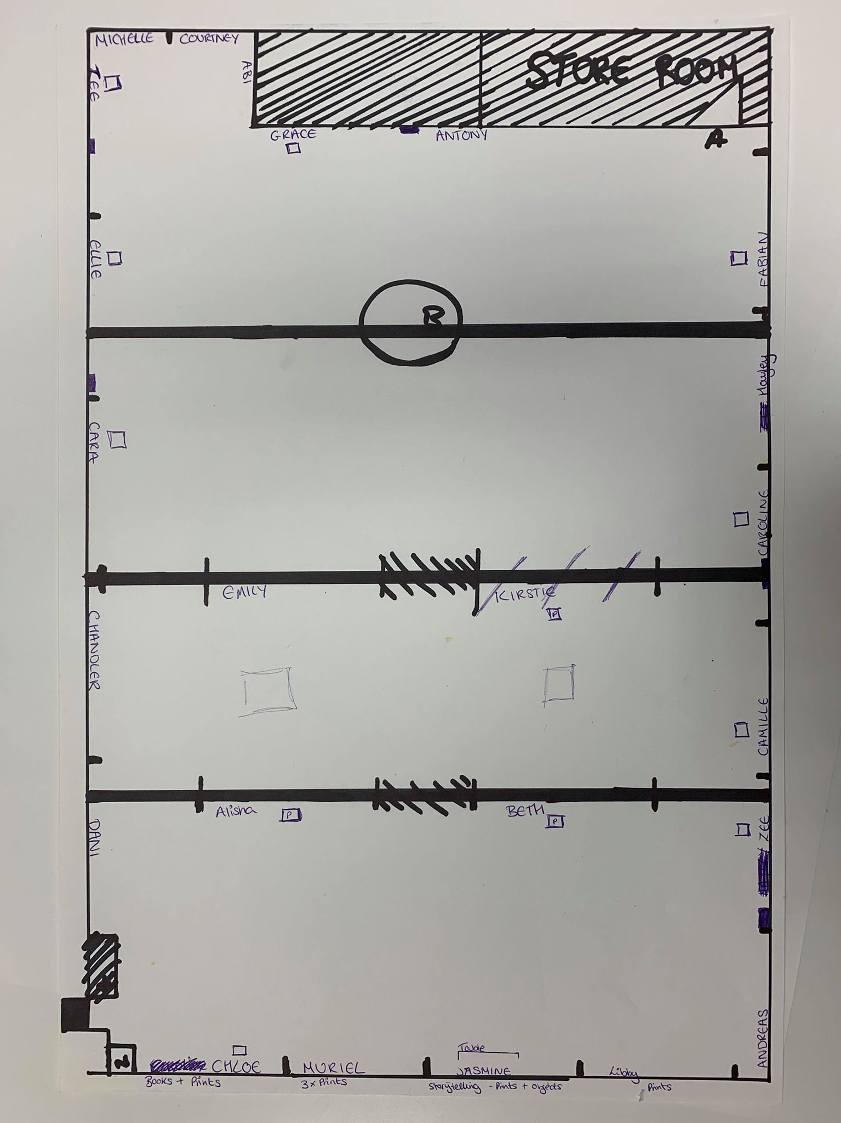
Initial
Plan
Notes:
Grace – Use the image to highlight the flaws.

Slide 9
Flaws in the Plan
After going back over our original design plan, the issue that caused the most concern was the location of the plug sockets and where placed in relation to people showing moving image pieces in the exhibition.
By placing these people within the gallery space first, we where able to make sure everyone who needed plug sockets had the access they needed. After rearranging the plan, as a team we were able to make a more efficient floor plan.
Our first issue concerting the gel lights was that Some people were happy with gels being put over their work, where as others were not happy with the gel lights.
As a team we released by having gels only on one or two to the lighting fixtures, would draw the audiences attention to those pieces of work, therefore making the people with LED's above their work appear to be the centre stage of the exhibition.
We decided an equal amount of ambience could be created using music.
Notes:
Grace – Realisation that there were parts of the initial plan that could go wrong.
Making these adjustments meant that we had a more concrete plan.
The speakers were loud enough to reach into the exhibition so we wanted to have music playing from the outside to compromise the absence of gel lighting.

Slide 10
Missing information
 | Prints: (amount) | Size: | Adjustments: (if needed)
Chloe Penny | 2 | A4
Kirstie Mccubin |  | A3 (width)
Libby – Ann Prestidge | 4 | A4 (A3 width??)
Hayley Rodriquez | 4 | A4
Ellie Thomas | 6 | A4
Camille Hughes | 2 | A3
Muriel Lagoutte | 3 | A4
Cara London | 2 | A3
Anthony Lim | 4 | A3
Fabian Melby | 2 | A3
Jasmine Pope | 6 | Square: (A4 width)
Daniela Marcelo Argente | 3 | Width: 27 cm Length: 60 cm
Chandler Bond | 5 | 8 x 8 in 11 x 11 frames
Emily Sawyer |  | Banner
Alisha Baxter |  | Banner
Zee Anibaba | 4 | A3
Abigail Hudson | 3 | 16 x 16 or 20 x 20
Missing information about the amount of prints and size was required to gain further understanding of how the floor space would proceed and tackles the issue of possible limitations that could have arise (missing information obtained by chandler ).
Notes:
Chandler – Explaining the diagram
The adjustments sections allowed the team to make adjustments with the design team.

Slide 11
Group Exhibition
We decided to concentrate in the Photo-London Gallery that is held in Somerset House in London.
Photo-London is one of the biggest Photo-Festivals in London. The fair presents the best historic and vintage works as well as contemporary artists.
The Photo-London website has virtual tours from 2016- 2019; so we took it upon ourselves to split up into two groups and research both 2018 and 2019 virtual tours.
Notes:
Libby – Talk about the what the types of works. (Vintage and historic)
Photo-London is home to many auctions of art works.

Slide 12
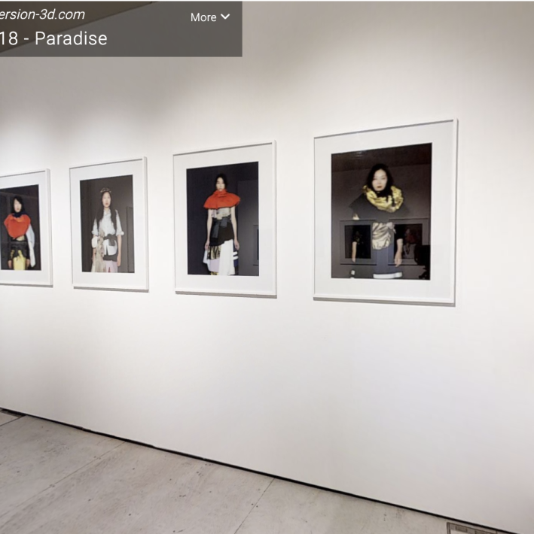
2018 Exhibit
In contrast to this the condition of the room could do with additional structures to hide what could perhaps detract from the images. - Chandler
The whole floor seems to have the majority of smaller prints. I think that the larger prints here take away from the other prints in the room. -Alisha
The tables work well with the layout as there it creates a break between the images at the back part of the gallery and those before, giving the illusion of a bigger space.- Anthony
Notes:
Libby – Talk in general about the exhibit

Slide 13
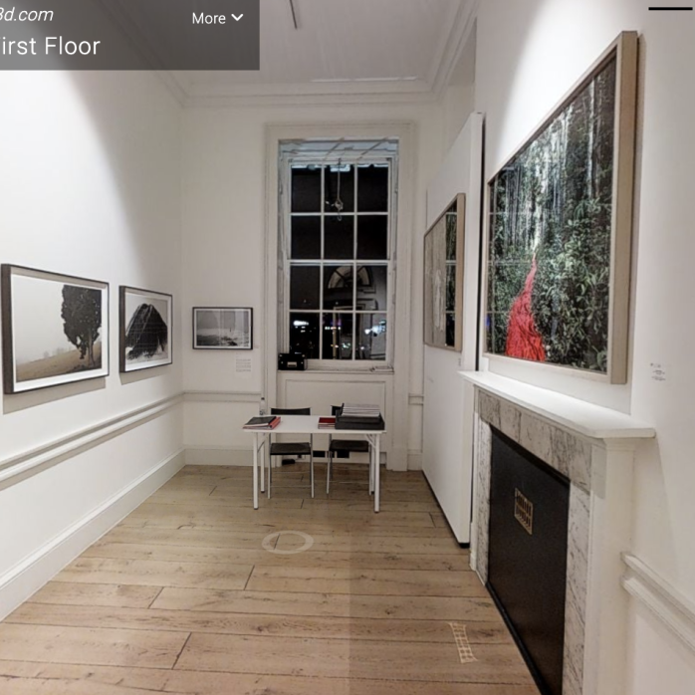
2019 Exhibit
The fact that I can view the room at a 360 degree with a flick of a mouse strengthens the interactive aspect of the tour which I strongly admire. - Libby
There are a few quirks to the exhibition site with buttons to change the view to a dollhouse, a floor plan view and even a measurement mode giving you a feel for the size of the space. – Courtney
By making the tour easy to use, more focus can be shifted to the artwork, which is crucial if the gallery is trying to achieve an immense and realistic approach. - Hayley
I think that the whole floor has a very homely feel with all the desks and chairs but this room especially as there is a very simplistic fireplace along with a desk with flowers. This reflects well in the prints being shown in the room as they have very earthy tones. - Kirstie
Notes:
Libby – Talk in general about the exhibit

Slide 14
Group Meeting
Having come up with some ideas about the layout, I wanted to have input from other groups to see what they wanted as well.
We chose to gave a small meeting as a way for everyone to get their voice across.
Everyone came with ideas that their team has been working on and what we needed to do from then on.
We brought the first plan of the exhibit and the idea of double sided banners. We wanted to create the concept of 'An exhibit inside an exhibit'. The other teams suggested the importance of lighting the banners as well.
We also put into discussion that we may have to liaise with fashion about transport if we needed extra plinths.
Notes:
Alisha
- Why the input from other groups was important – its everyone’s exhibit, we should have a general sense of approval as it is everyone exhibit.
- Talk about the use of double sided banners.

Slide 15
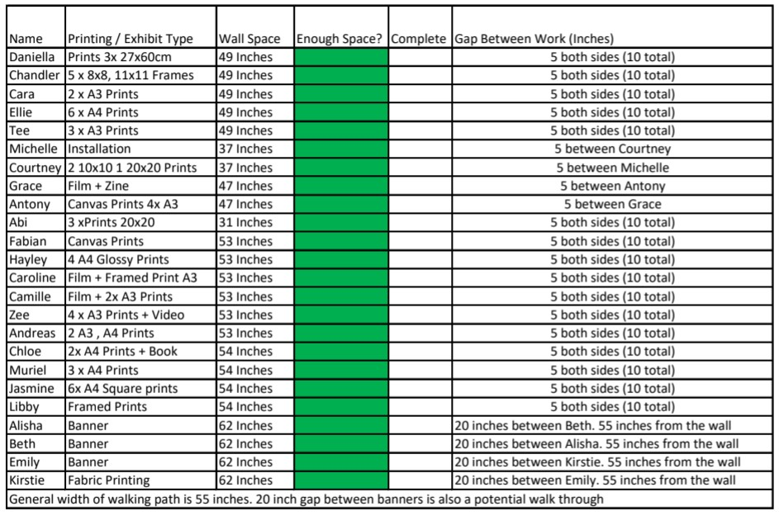
Spacing and Sizes
When deciding the spaces for all the work and how each person will get, we took into account plugs, the medium in which they wish to display their work, and how many people we have.
We decided that the work would not be larger than 2 A3 sheets, so that everyone would have enough space.
Some problems with the sizes were that we didn’t have everyone's preferred mode of work, as we wanted to take into account if they would be showing video or prints - in this case, the videos would need less of a space as it would be on a plinth. Another problem is the size of the gallery itself.
Notes:
Anthony - Talk about using 5 inch spacer between each work.
Banners will be held by weights to straighten them out.
We did not want to display work that was too overwhelming.
How the chart helps install team.

Slide 16
Second Year meeting 16/03
Design team
After deciding the place the refreshments table in near the top half of the room, we found that it may be a fire hazard, and that Nucleus Cafe themselves will be providing the table and refreshments.
We discussed the possibilities of a comments book, for the visitors to leave comments about their experience in the exhibition. Vinyl is another option to print on.
Finally, we went over invigilation times, deciding 2 per slot, one in the morning and one in the afternoon.
Promotion Team
The promo team had finished designing the zine and poster for the exhibition. However, some people are not yet in the zine as they have not sent in their work yet.
Install Team
There was not much to say for the install team as we had not reach that stage yet in the exhibition.
Notes:
Anthony-(DT) We wanted a circular table but this is not possible either.
Nice interactive element to it.
Double check the amount of monitors that we have and if they were working.
(PT) Website design had misspelled/duplicate names on the website so this would be revisited.
(IT) They were told to make sure we had enough plinths for the monitors to sit on.

Slide 17
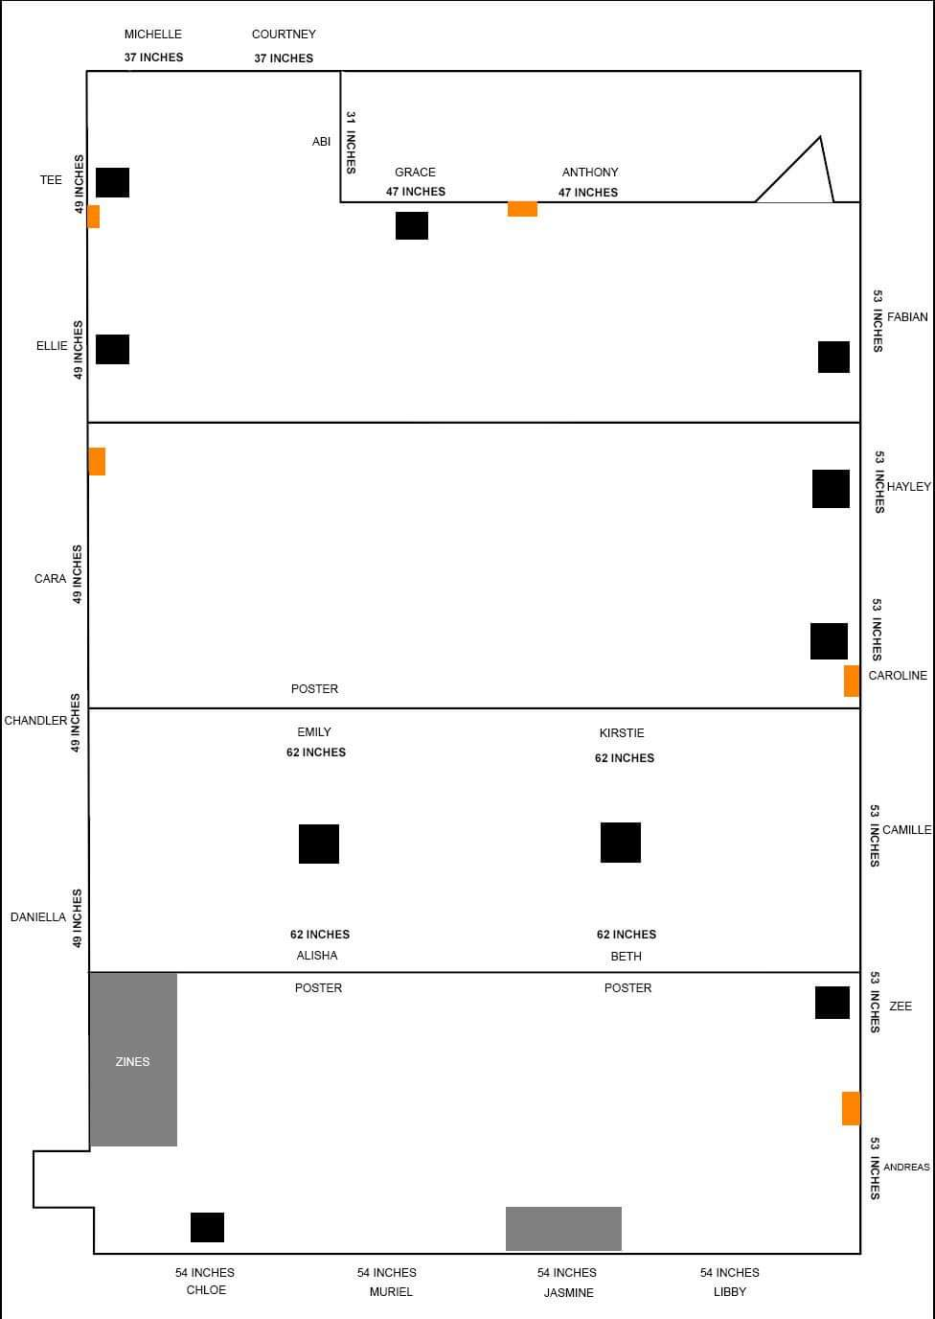
Final
Plan
Notes:
Alisha
Explain what the different colours meant.
Black – Plinth
Orange – Plug socket
Grey – Table

Slide 18
Final plan
Once we came up with the final plan, we decided to send this out to the other teams so that they can have an input onto the plan.
We really liked this floor plan as we felt that everyone in the exhibit got the opportunity to express their work in their own way.
There was a 55 inch gap in between the wall and the banners with a 7.8 inch gap in between each banner.
However, the promotions team did not like the idea of having posters within the centre of the exhibit and they also thought that the banners were cramped as well.
We asked the promotion team to create a layout based on this one to see what they would change.
Notes:
Alisha – This was our decision to make even after the feedback from the other teams.
Third railing meant that the work could get lost.

Slide 19
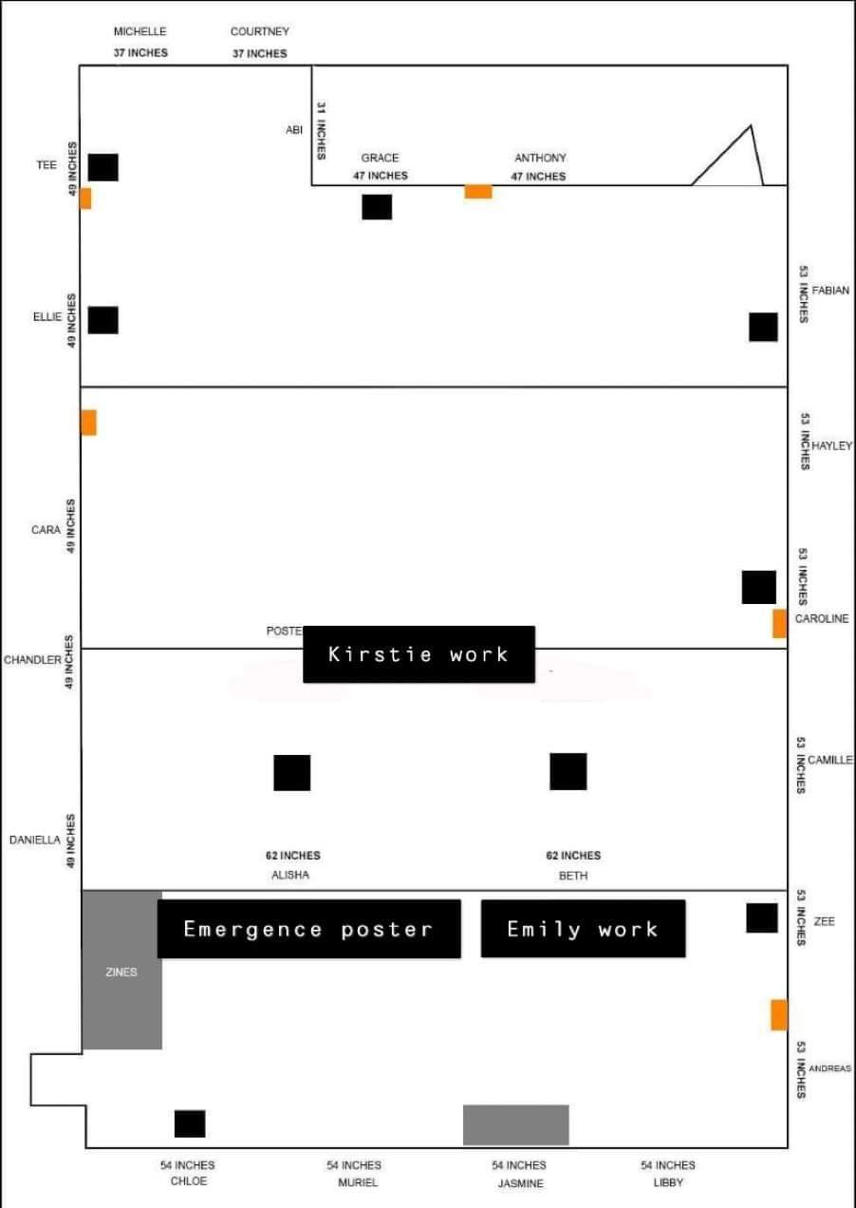
Notes:
Alisha – We felt that this layout made the banners seemed squished
Kirstie’s work was on fabric – this meant that it was different.
Decided to go with the original plan as the majority was happy with this.

Slide 20


Notes:
Alisha – How the posters ended up looking

Slide 21
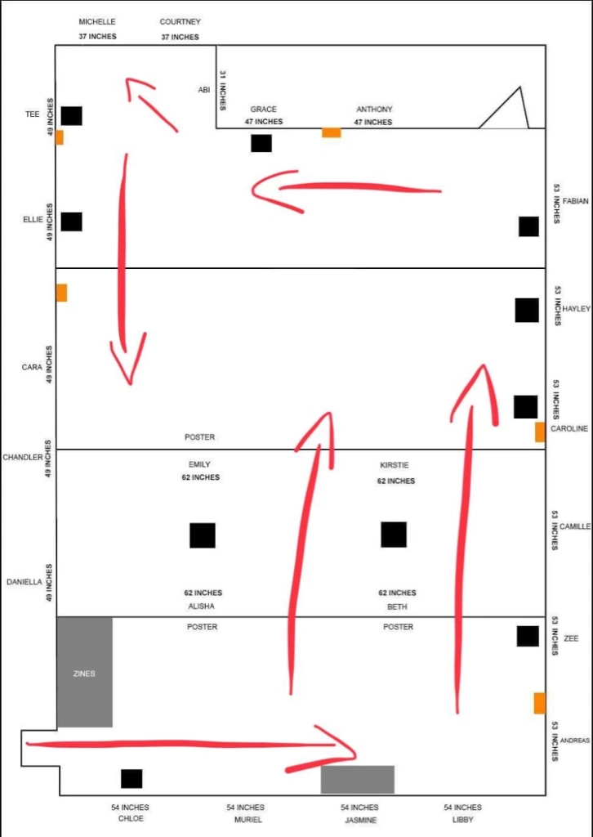
The flow of the viewers
The two red arrows explained lead to a space of which is empty and, in my opinion,, this needs something to help maintain the flow of viewers around the room, something to guide them.
I noticed some rooms had tables or benches to enable viewers to pause and sit/look at the works.
There might be a differ on the way they approach the way to start but this is generally something that happens regardless
Notes:
Courtney – Discuss the diagram
Talk about how the bench could possibly disrupt the flow of the viewers

Slide 22
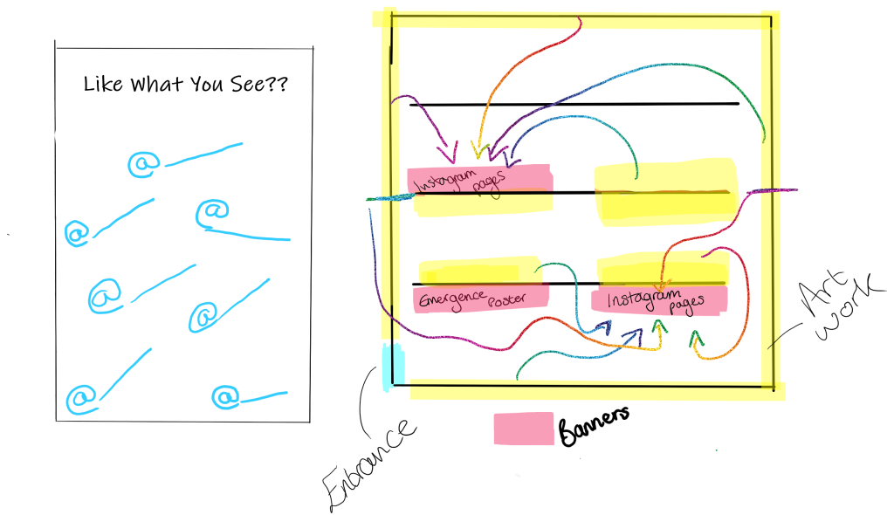
Ideas that didn’t end up working
Promoting each Photographer
One idea that myself and Grace thought of was creating posters that were a way of promoting their work further.
As the emergence poster is black, we were worried that this would result in a dark poster that could darken the whole exhibit. To rectify this, we would have changed the black to white as a way to brighten up the exhibit
This idea did not follow through as this idea was not well liked by the other teams.
The Promotions team though that this could potentially become too wordy and not look the way that the exhibit should. As this was not well liked, we all mutual agreed to change this into something that we would all have liked.
Notes:
Alisha – Promoting meant that we could collaborate with the promotions team. Talk about the catch of the banner making it better on the eye.

Slide 23
Invigilation – Prep &Amp
We had to figure out not only where everyone's work was going to be placed as well as other key components of the show i.e refreshments table, zine table etc.
I needed to do some research about the timings of the show, the days they were going to be displayed, how many people were available to participate as our class has both mature students as well as people who work alongside doing uni.
Prior to the meeting, Grace and I worked out that the invigilation should be three people in three hour slots. Originally it was with two people as we didn't wanna take up too much room since the gallery was on the smaller side, but we decided to stick with three as it allow more people to be involved at least once, making it fair.
However, due to circumstances out of our control, we never had the chance to. I believe, however, the task was able to be accomplished if given the chance.
Notes:
Hayley – I decided to look into the planning of the invigilation.
Thought of having chairs for the invigilation.

Slide 24
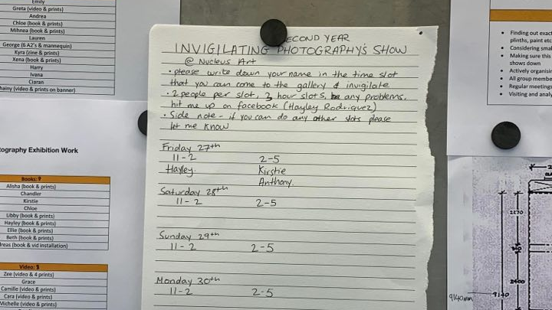
Notes:
Hayley – Showing how the invigilation would have worked

Slide 25
Installation Day
In consideration of the exhibition going ahead the team collectively, in collaboration with the install team, would instruct on where the work goes as well as how it would be hanged within the gallery space.
This clear line of communication would allow us to achieve the goal of communicating with other groups to progressively exhibit the work.
Notes:
Chandler – The importance of having the curating team so that the floor plan is followed through.

Slide 26
Evaluation
In this unit, our team were essentially the building blocks. The team and the tasks given allowed us to really engage with the material and how we could create a plan that relates to everyone's work, we needed to design something that will not only allow everyone's work fairly but also something that captivates the viewers.
Also, alternative aesthetics were suggested for the promotion posters that were intended to hang behind some work, however it wasn't changed as it didn't really fit the feeling we were going for.
rough personal and group research as well clear communication to each other in the team, we were all able to come up with things to discuss for this blog, as well as participating in the development the show.
Notes:
Hayley – We were continuously developing ideas adding a level of challenge that wasn’t too overwhelming.
The floor plan was one of the main things that we had to create during the unit.

